Slide 1

Hoe OpenChain ISO 5230 Werkt
Notes:
The OpenChain Project is here to help improve compliance processes and build trust across the supply chain.

Slide 2
OpenChain ISO 5230 definieert de belangrijkste vereisten van een kwaliteitsvol open source-compliance programma. Het OpenChain Project ontwikkelt deze standaard. Onze visie is een leveringsketen waarin open source wordt geleverd met betrouwbare en consistente compliance-informatie. Het is onze missie om vereisten vast te stellen om effectief beheer van open source voor deelnemers aan de softwareleveringsketen te bereiken
Notes:
The most important point about how OpenChain is run related to who is running it. The project is run by user companies for user company. Everything we do is service to this and to the shared need for practical, real world solutions to address managing open source code.

Slide 3
OpenChain maakt betrouwbare en consistente compliance-informatie in de leveringsketen mogelijk
stroomopwaarts
stroomafwaarts
inkomend
Open Source Compliance…
Vastgeteld Programma
Taken gedefinieerd
Beoordelings- en goedkeuringsproces
Compliance artefacten -verzameld
Beleid voor communitybetrokkenheid
outbound
Notes:
It defines the big picture, showing the inflection points where a company should have processes, policies or training.

Slide 4
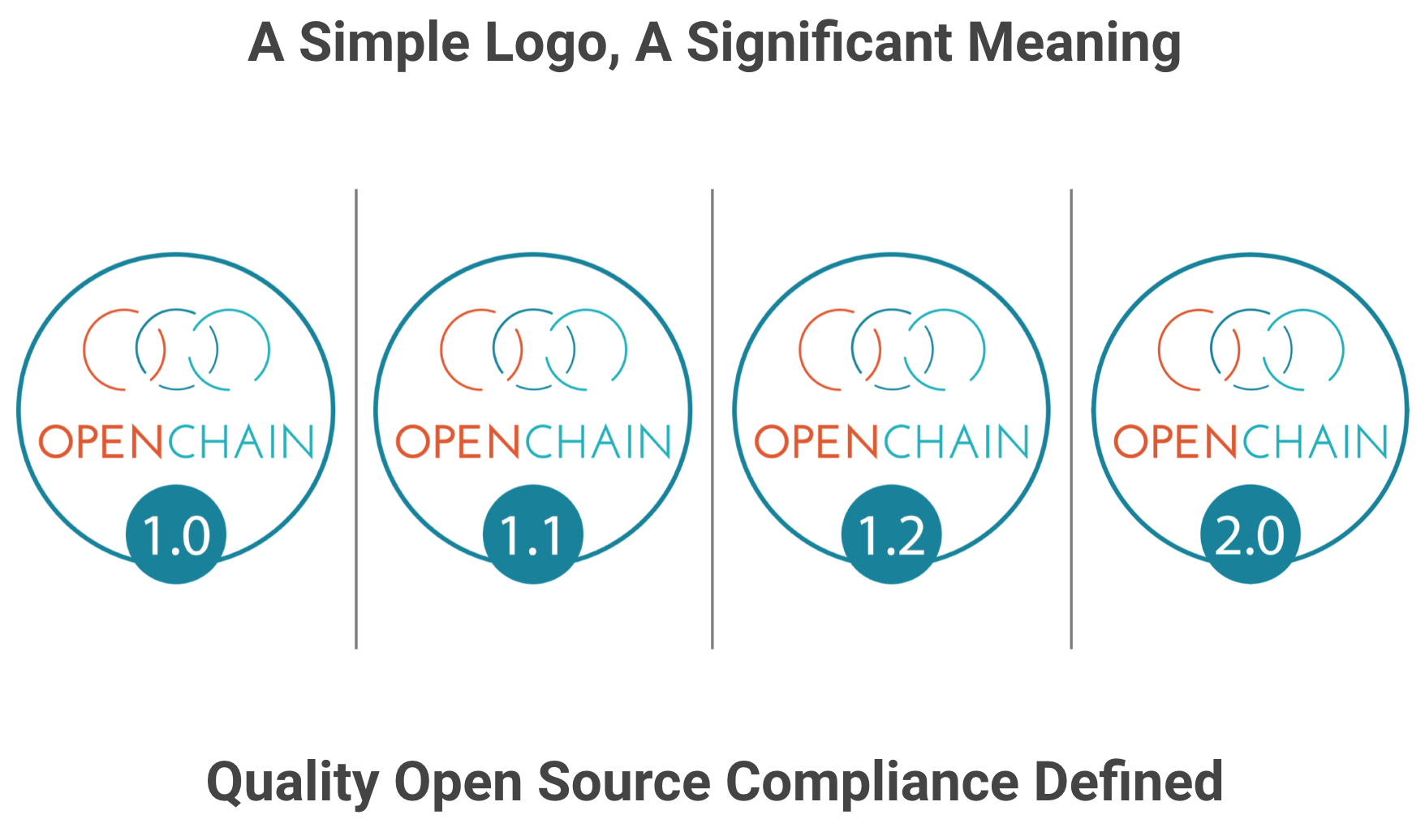
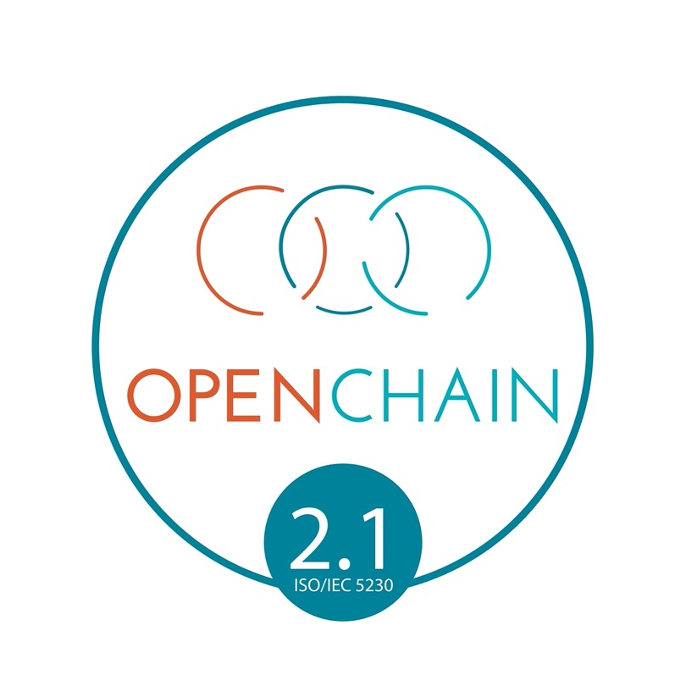
Een simpel Logo, Een Belangrijke Betekenis
Notes:
Companies that meet the OpenChain Specification requirements can use a badge to identify their OpenChain Conformant program and the products that went through this program.

Slide 5

Ons werk wordt mogelijk gemaakt door onze Platinum-leden
Notes:
Here are the current Platinum Member companies in the OpenChain Project.

Slide 6
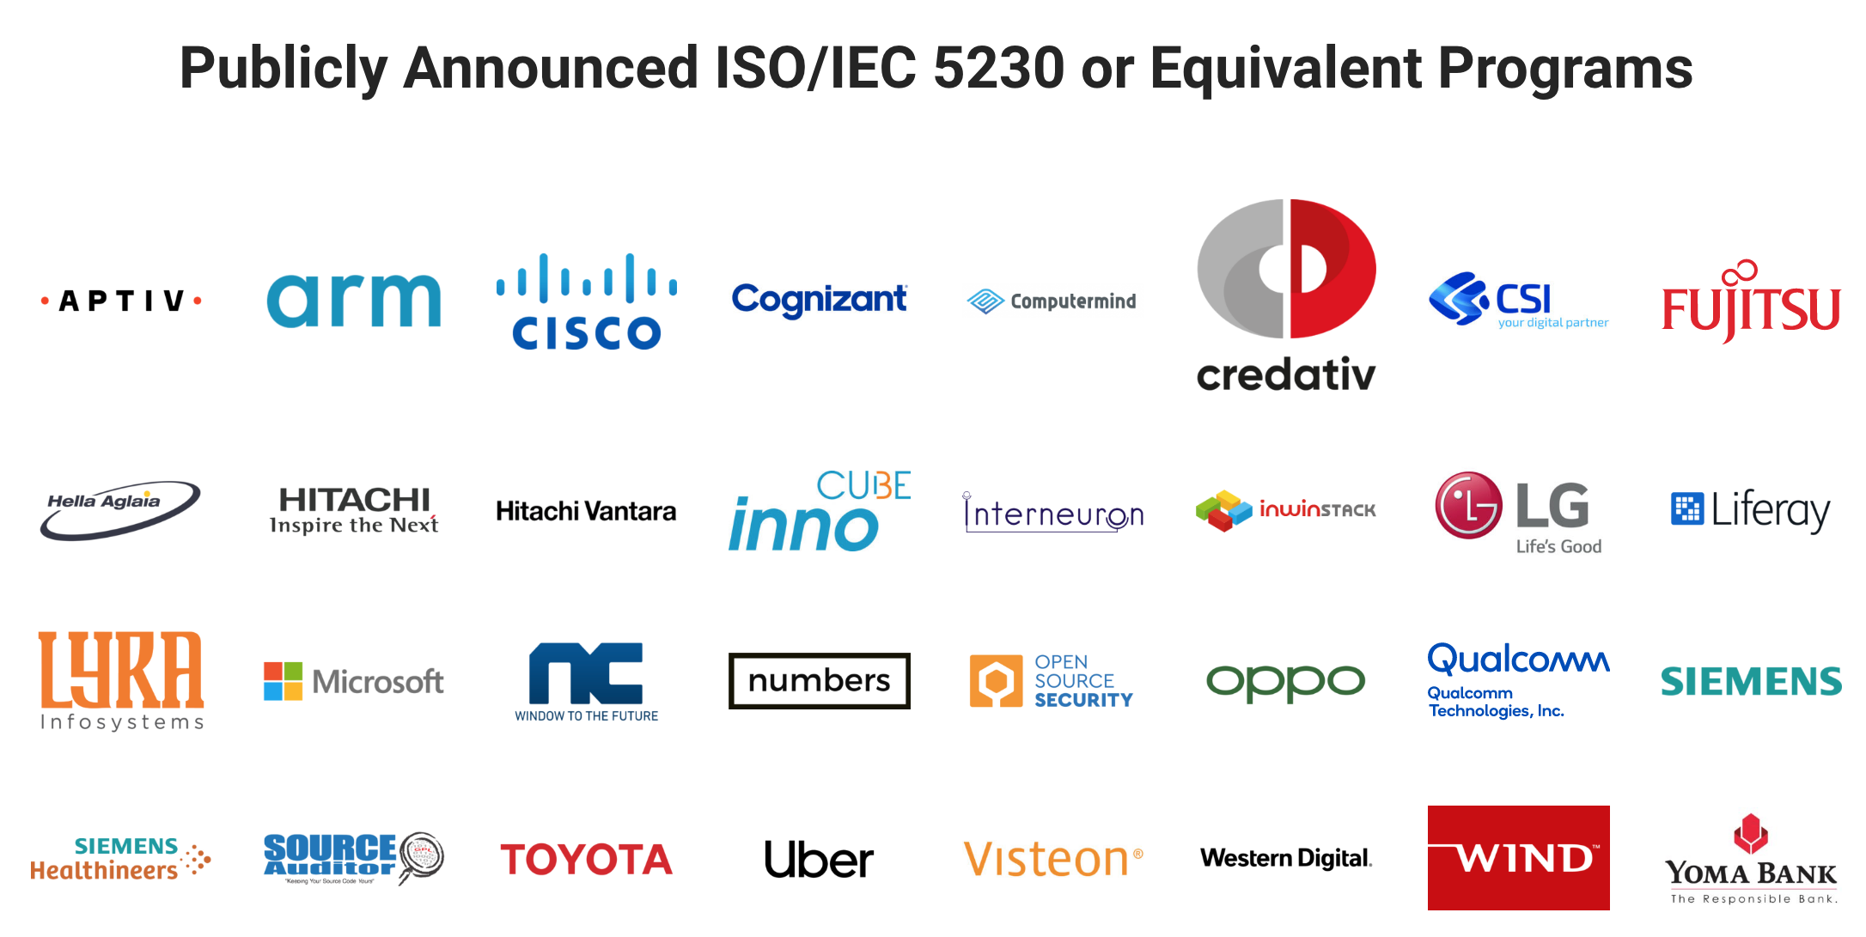
Openbaar aangekondigde ISO / IEC 5230 of gelijkwaardige programma's
Notes:
There are a number of companies with a publicly announced OpenChain Conformant program that adheres to the requirements of ISO 5230. These companies come from a wide range of industries and represent a wide range of company sizes. Of course, there are many more undergoing OpenChain Conformance or without a publicly announced program.

Slide 7
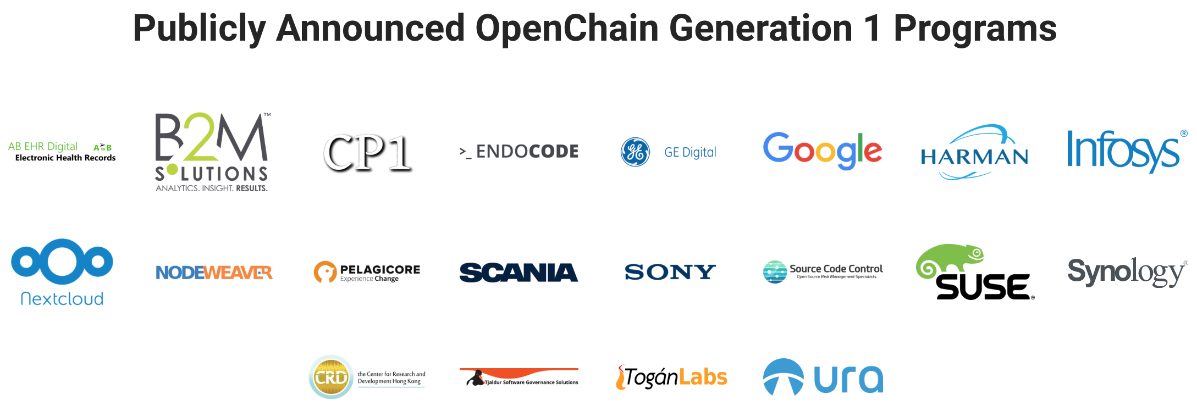
Openbaar aangekondigd
"OpenChain Generatie 1" programma's
Notes:
There are a number of companies with a publicly announced OpenChain Conformant program related to the first generation of the OpenChain Specification. While not adhering to the specific terms of ISO 5230, these companies are in an excellent position regarding adoption.

Slide 8
Globale + Lokale Communities
Global Mailing List
Global GitHub
Global Automotive
Global Education
Global Reference Tooling
China Work Group
Germany Work Group
India Work Group
Japan Work Group
Korea Work Group
Taiwan Work Group
UK Work Group
USA Work Group
Notes:
OpenChain has extensive local and global work groups actively support adoption with reference material and other community activities.

Slide 9
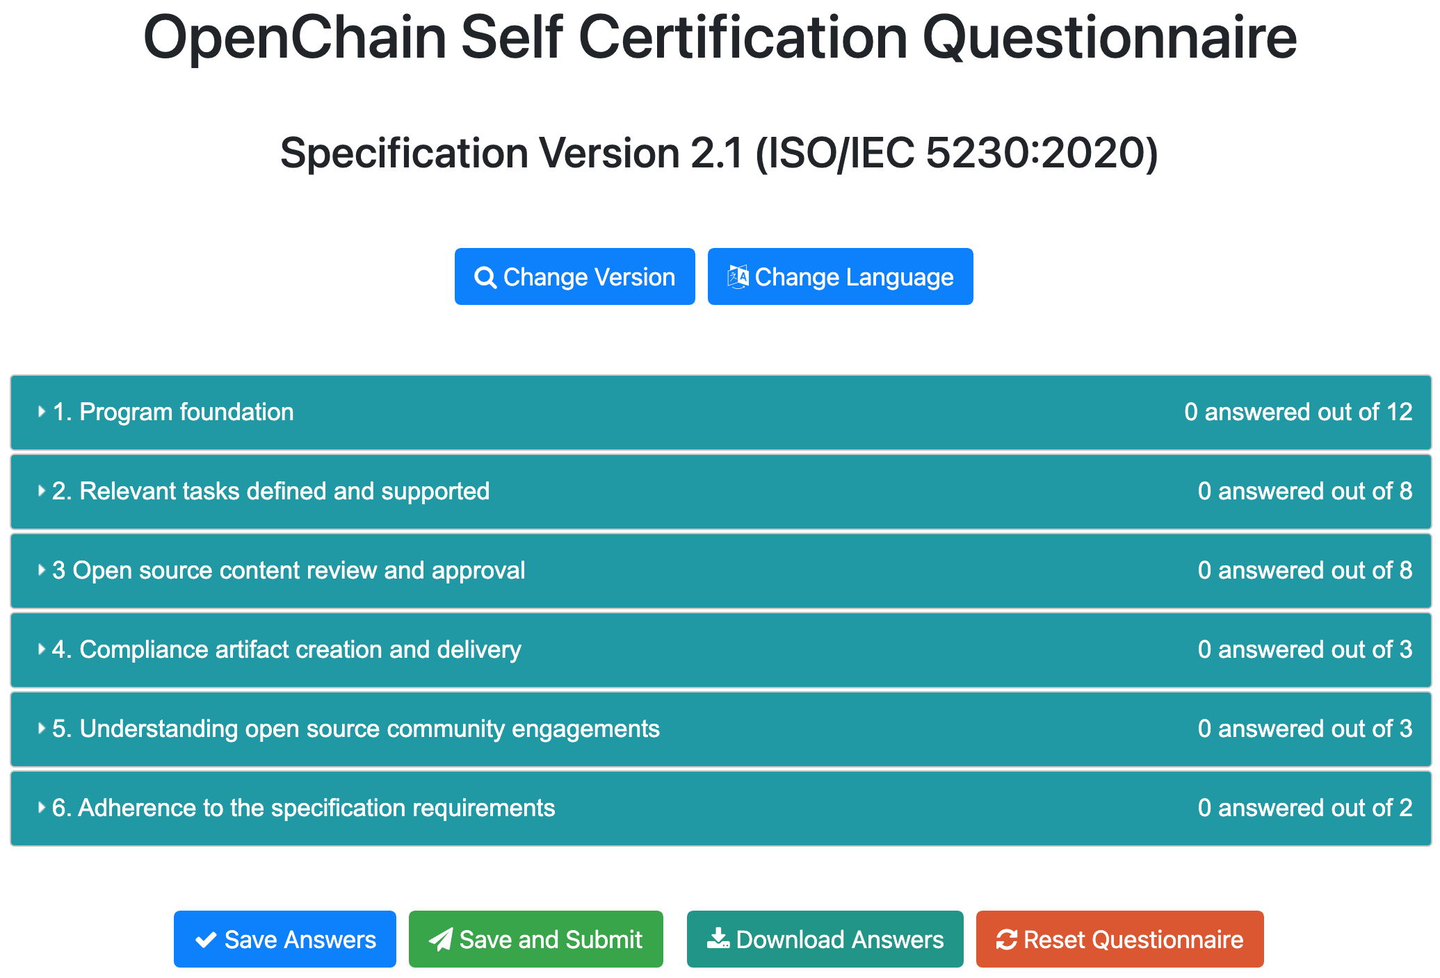
OpenChain Zelfcertificeringsvragenlijst
Notes:
We have a free self-certification web app with a responsive interface for computers, tablets and mobile phones. It is designed to allow any company in any market to quickly and easily conduct a private “compliance program health check” or to record conformance to the OpenChain Specification.

Slide 10
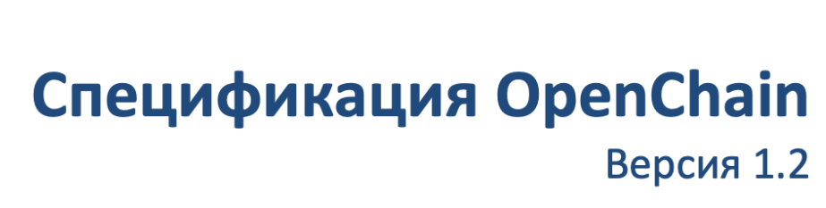
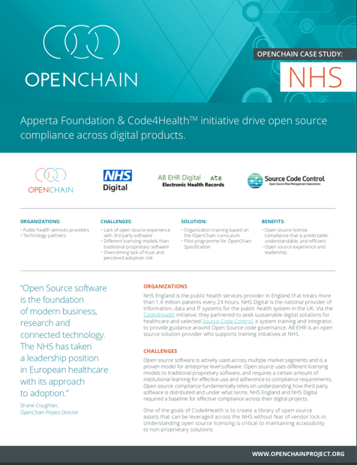
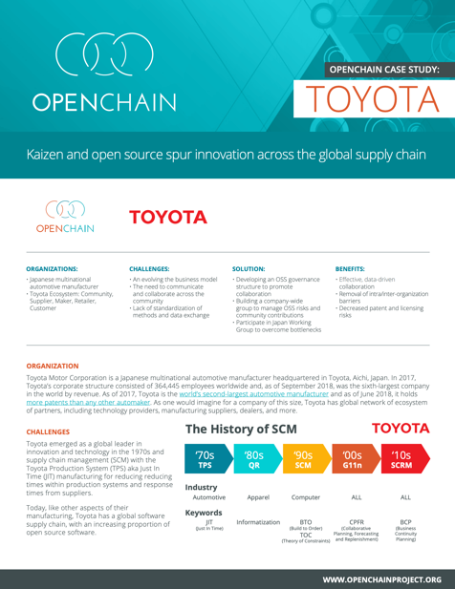
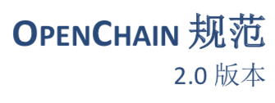
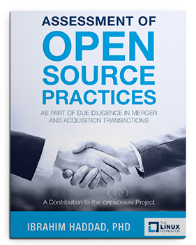

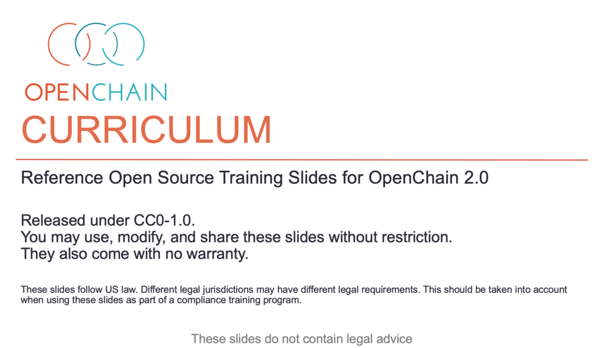
Uitgebreide Referentiemateriaal
Notes:
We provide a wide range of reference materials and translations to assist with conformance.

Slide 11
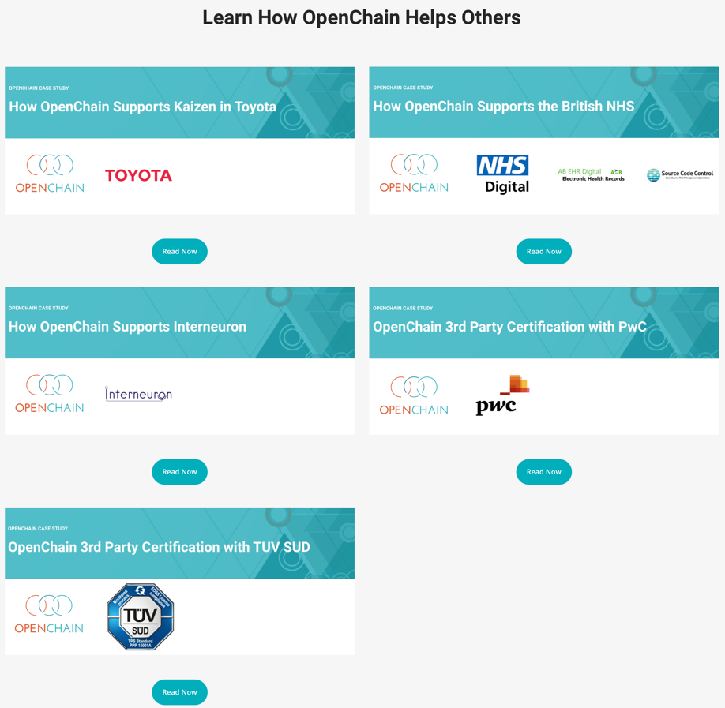
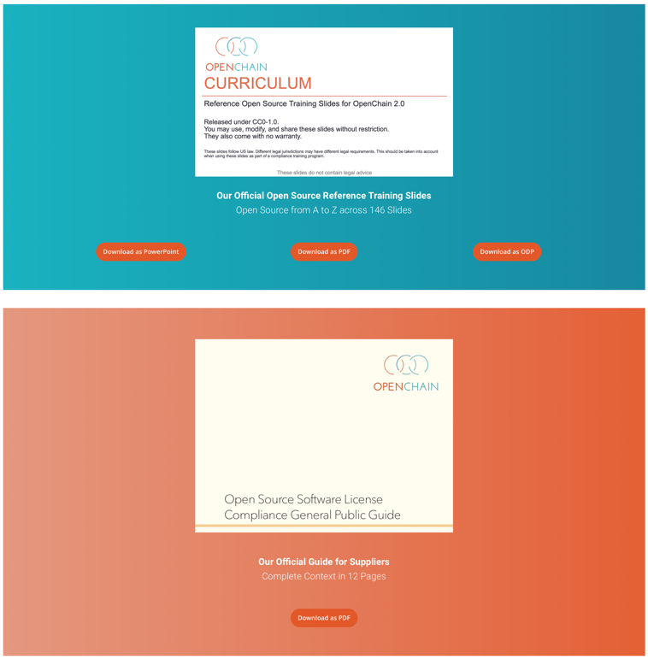
Notes:
The key reference items are provided directly on our website.

Slide 12
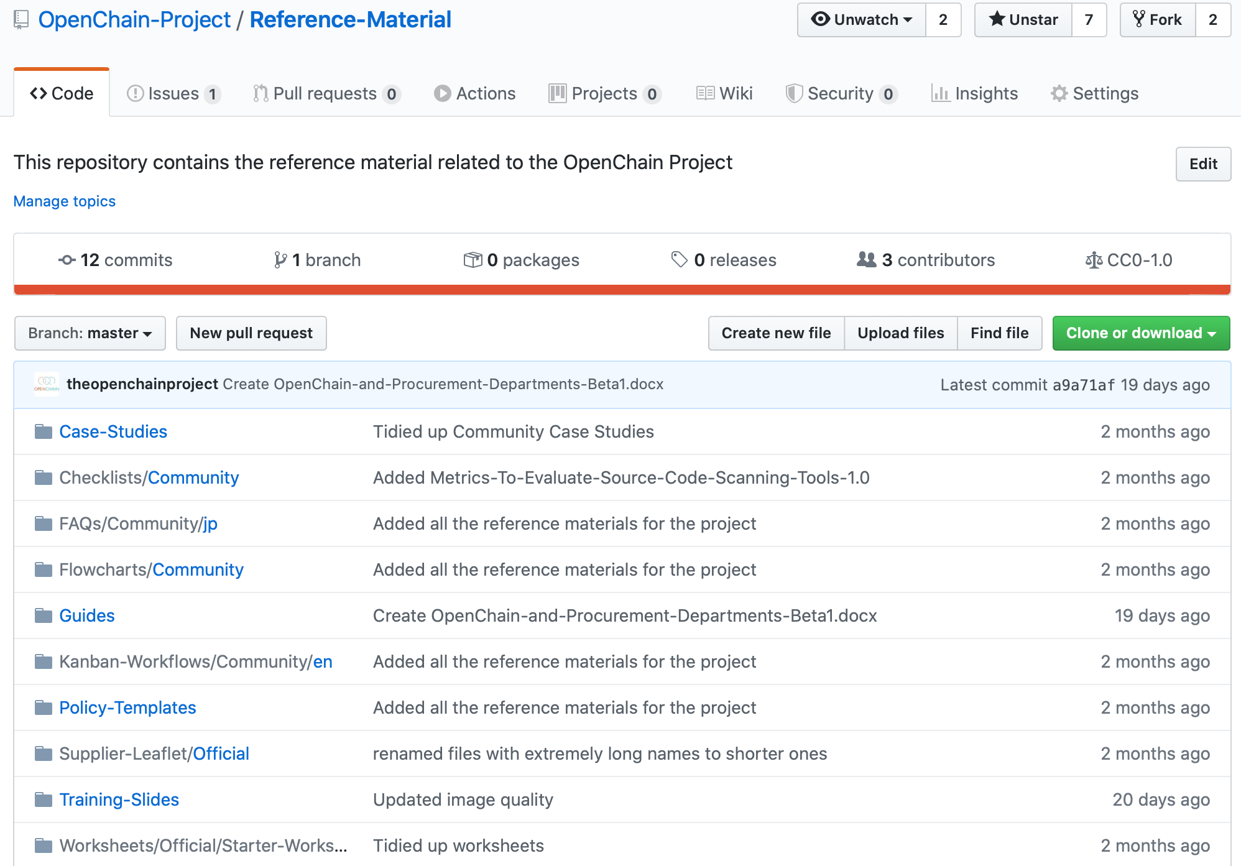
Notes:
A great deal of other information can be found on our GitHub repositories.

Slide 13
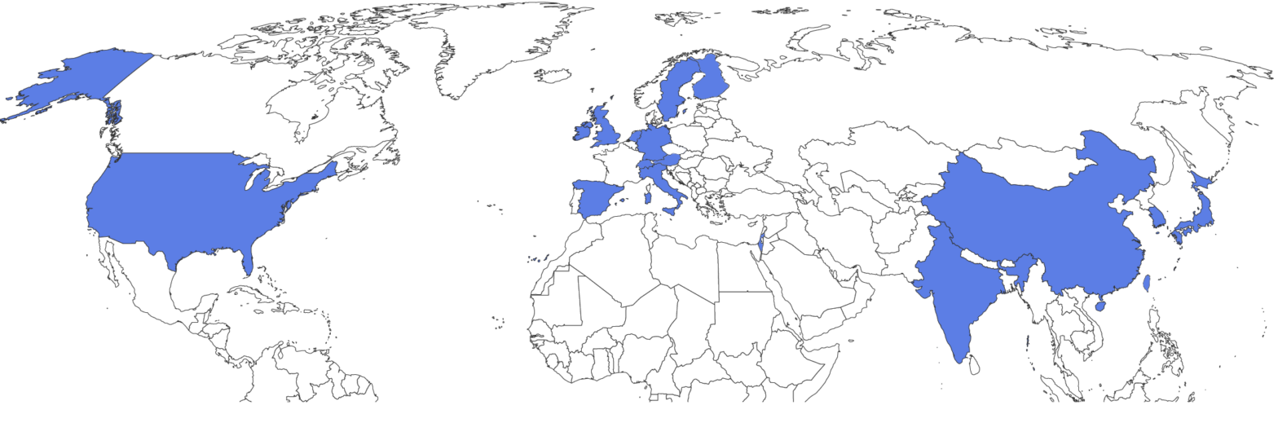
Partner programma – Wereldwijde fysieke locaties
Notes:
We have substantial and growing geographic coverage for the partner program. It now covers a significant number of strategic geographic locations, including the United States, China, South Korea, India, Japan, the UK, Germany, Italy, Spain, Sweden Ireland and The Netherlands.

Slide 14
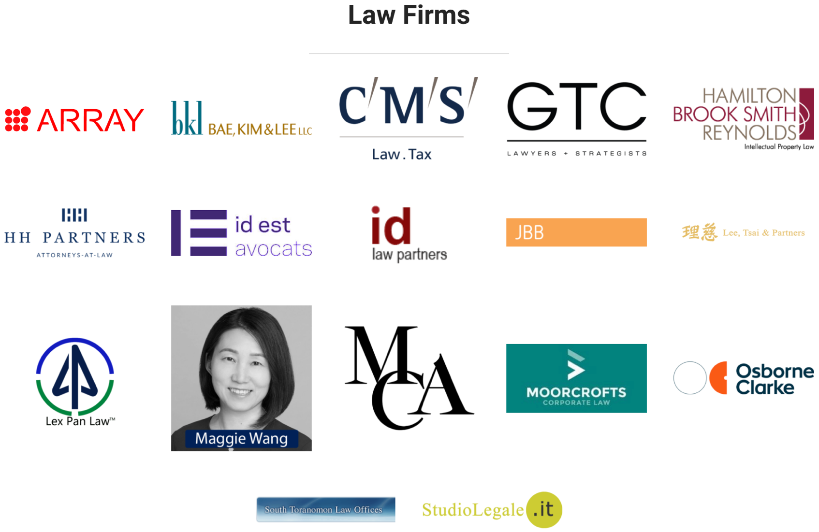
Advocatenkantoren
Notes:
We have substantial and growing geographic coverage for the partner program. It now covers a significant number of strategic geographic locations, including the United States, China, South Korea, India, Japan, the UK, Germany, Italy, Spain, Sweden Ireland and The Netherlands.

Slide 15
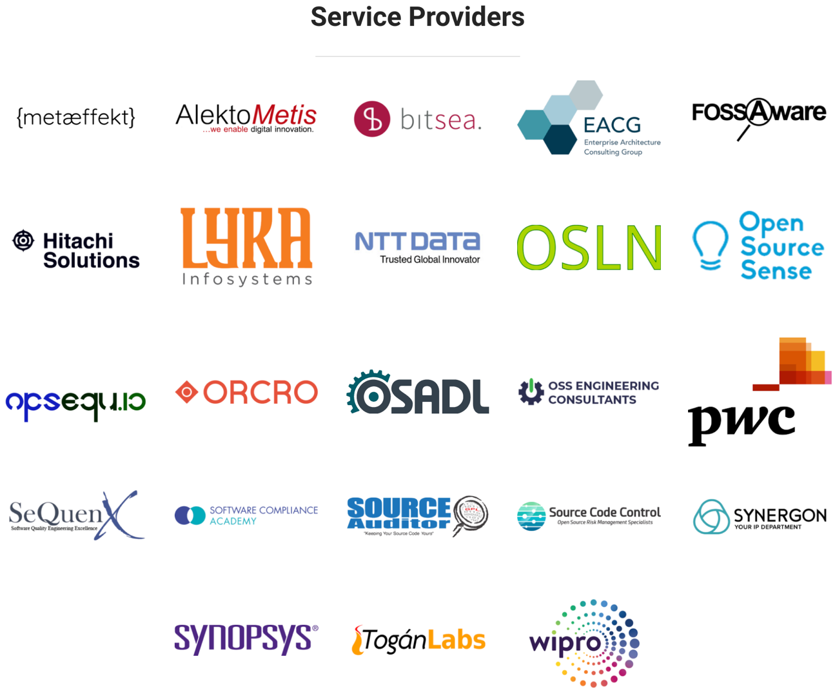
Dienstverlener / Service Provider
Notes:
We have substantial and growing geographic coverage for the partner program. It now covers a significant number of strategic geographic locations, including the United States, China, South Korea, India, Japan, the UK, Germany, Italy, Spain, Sweden Ireland and The Netherlands.

Slide 16

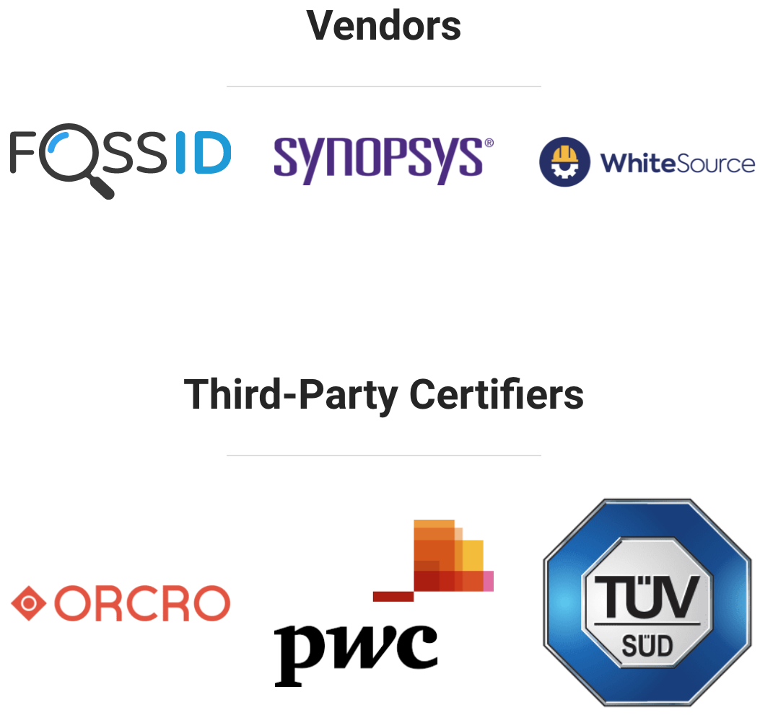
Certificeringsdienstverlener
Notes:
We have substantial and growing geographic coverage for the partner program. It now covers a significant number of strategic geographic locations, including the United States, China, South Korea, India, Japan, the UK, Germany, Italy, Spain, Sweden and Ireland.

Slide 17

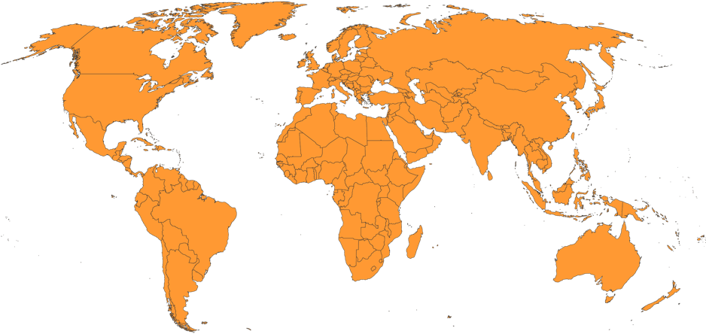
Externe certificeerders / certificatie-instellingen
Notes:
TUV Sud and PwC both offer third party certification globally.

Slide 18
Aan de OpenChain-standaard kan worden voldaan door: Zelfcertificering Onafhankelijke compliance beoordeling Certificering door derden
Keuzevrijheid voor klanten en leveranciers
Notes:
When it comes to meeting the OpenChain industry standard for open source compliance, we are fostering a diverse series of options for our diverse range of stakeholders, from self-certification to independent compliance assessments to third party certification.

Slide 19


Kwaliteits compliance van OpenChain Frames
Voorbeeld implementatiekeuzes
Open Source Compliance Programma…
Software Bill of Materials
Vastgeteld Programma
Taken gedefinieerd
Beoordelings- en goedkeuringsproces
Compliance artefacten verzameld
Beleid voor communitybetrokkenheid
Automatisering om upstream, interne ontwikkeling en downstream open source software te identificeren
The Projects And Tools Cited Are For Reference only. OpenChain ISO 5230:2020 is not prescriptive regarding process implementation choices.
Notes:
Compliance is core to effective strategic engagement with open source technology. It is very important that we can contextualize this effectively for our supply chains. There are various pre-existing industry standards to help contextualize solutions in this space (OpenChain and SPDX) and there is extensive tooling to support automation.

Slide 20
Zelfcertificering vormt de kern van de OpenChain-industriestandaard. Bedrijven hebben toegang tot een reeks ja/nee-vragen om te bepalen of ze de belangrijkste vereisten van een hoogwaardig open source-complianceprogramma hebben geïmplementeerd. Deze vragen vind je hier: https://certification.openchainproject.org
Zelfcertificering
Notes:
Self-Certification is at the heart of the OpenChain industry standard. Companies can access a series of yes/no questions to determine if they have implemented the key requirements of a quality open source compliance program. These questions can be found here: https://certification.openchainproject.org

Slide 21
Onafhankelijke compliance beoordeling is wanneer een onafhankelijke partij, zoals een advocatenkantoor, adviesbureau of accountantskantoor, het product van een OpenChain-zelfbeoordeling bestudeert en advies geeft over de vraag of zij het als volledig beschouwen.
Onafhankelijke compliance beoordeling
Notes:
Independent Compliance Assessment works in the same was as the Independent Security Assessment in ISO26262. An independent party such as a law firm, consultancy or accounting firm reviews the product of an OpenChain Self-Assessment and offers guidance on whether they perceive it as complete.

Slide 22
Certificering door derden is een proces waarbij een certificeringsinstantie een bedrijf door een OpenChain ISO 5230-conformiteitsproces leidt. De certificatie-instelling geeft vervolgens een formeel conformiteitscertificaat af. Deze activiteit komt precies overeen met de vormen van certificering door derden die worden waargenomen rond auto's, infrastructuur en soortgelijke gebieden en ISO-normen.
Certificering door derden
Notes:
Third-Party Certification is a process whereby a certification authority guides a company through an OpenChain Conformance Process. The certification authority then issues a formal certification document. This activity maps precisely to the forms of third-party certification observed around automotive, infrastructure and similar fields.

Slide 23
Aan de Slag
Verken onze community: https://www.openchainproject.org/get-started
Zelfcertificering of gezondheidscheck van een organisatie: https://certification.openchainproject.org
Notes:
Please reach out to us if you have any comments, questions or ideas for participation and improvement.

